Slide 1
Monopoly
CHAPTER 15
Notes:
N. Gregory Mankiw Principles Of Economics Eight Edition

Slide 2
Why Monopolies Arise Part 1
Market power
Alters the relationship between a firm’s costs and the selling price
Monopoly
Charges a price that exceeds marginal cost
A high price reduces the quantity purchased
Outcome: often not the best for society

Slide 3
Why Monopolies Arise Part 2
Governments
Can sometimes improve market outcome
Monopoly
Firm that is the sole seller of a product without close substitutes
Price maker
Cause: barriers to entry

Slide 4
Why Monopolies Arise Part 3
Barriers to entry
A monopoly remains the only seller in the market
Because other firms cannot enter the market and compete with it
Monopoly resources
Government regulation
The production process

Slide 5
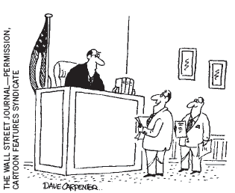
Why Monopolies Arise Part 4
Monopoly resources
A key resource required for production is owned by a single firm
Higher price
“Rather than a monopoly, we like to consider ourselves ‘the only game in town.’”

Slide 6
Why Monopolies Arise Part 5
Government regulation
Government gives a single firm the exclusive right to produce some good or service
Government-created monopolies
Patent and copyright laws
Higher prices
Higher profits

Slide 7
Why Monopolies Arise Part 6
Natural monopoly
A single firm can supply a good or service to an entire market
At a smaller cost than could two or more firms
Economies of scale over the relevant range of output
Club goods
Excludable but not rival in consumption

Slide 8
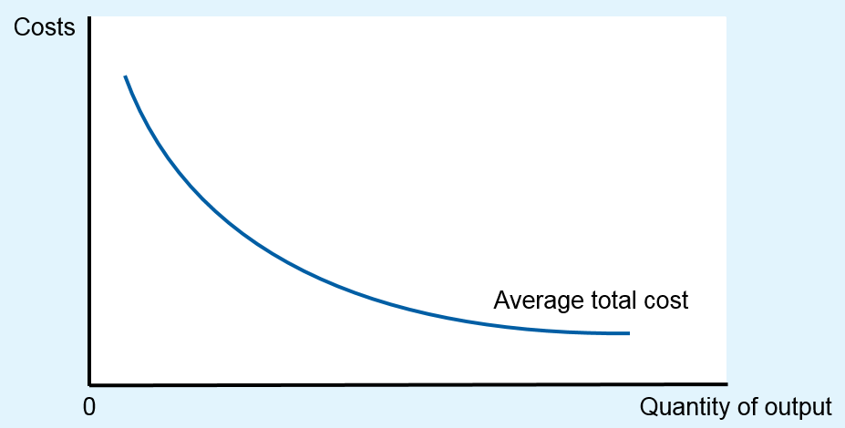
Figure 1 Economies of Scale as a Cause of Monopoly
When a firm’s average-total-cost curve continually declines, the firm has what is called a natural monopoly. In this case, when production is divided among more firms, each firm produces less, and average total cost rises. As a result, a single firm can produce any given amount at the lowest cost.

Slide 9
Production and Pricing Decisions Part 1
Monopoly
Price maker
Sole producer
Downward sloping demand: the market demand curve
Competitive firm
Price taker
One producer of many
Demand is a horizontal line (Price)

Slide 10
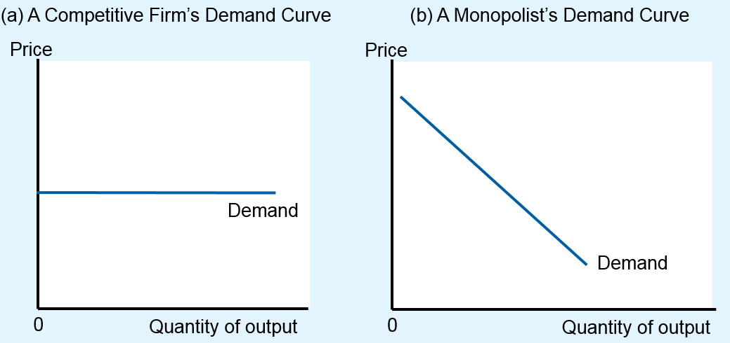
Figure 2 Demand Curves for Competitive and Monopoly Firms
Because competitive firms are price takers, they face horizontal demand curves, as in panel (a).
Because a monopoly firm is the sole producer in its market, it faces the downward-sloping market demand curve, as in panel (b). As a result, the monopoly has to accept a lower price if it wants to sell more output.

Slide 11
Production and Pricing Decisions Part 2
A monopoly’s total revenue
Total revenue = price times quantity
A monopoly’s average revenue
Revenue per unit sold
Total revenue divided by quantity
Always equals the price

Slide 12
Production and Pricing Decisions Part 3
A monopoly’s marginal revenue
Revenue per each additional unit of output
Change in total revenue when output increases by 1 unit
MR < P
Downward-sloping demand
To increase the amount sold, a monopoly firm must lower the price it charges to all customers
Can be negative

Slide 13
Table 1 A Monopoly’s Total, Average, and Marginal Revenue
(1) Quantity of Water (Q) | (2) Price (P) | (3) Total Revenue (TR = P x Q) | (4) Average Revenue (AR = TR/Q) | (5) Marginal Revenue (MR= (∆TR/AQ)
0 gallons | $11 | $0 | - | empty
1 | 10 | 10 | $10 | $10
2 | 9 | 18 | 9 | 8
3 | 8 | 24 | 8 | 6
4 | 7 | 28 | 7 | 4
5 | 6 | 30 | 6 | 2
6 | 5 | 30 | 5 | 0 -2
7 | 4 | 28 | 4 | -4
8 | 3 | 24 | 3

Slide 14
Production and Pricing Decisions Part 4
Increase in quantity sold
Output effect
Q is higher: increase total revenue
Price effect
P is lower: decrease total revenue
Because MR < P
Marginal-revenue curve is below the demand curve

Slide 15
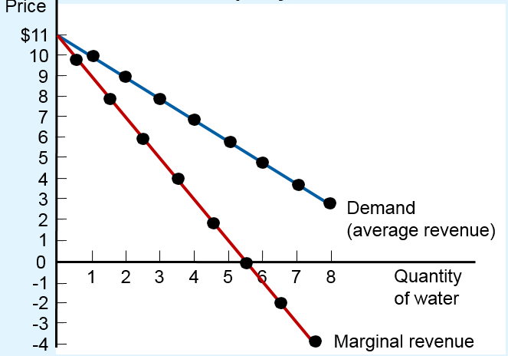
Figure 3 Demand and Marginal-Revenue Curves for a Monopoly
The demand curve shows how the quantity sold affects the price of the good.
The marginal-revenue curve shows how the firm’s revenue changes when the quantity increases by 1 unit.
Because the price on all units sold must fall if the monopoly increases production, marginal revenue is less than the price.

Slide 16
Production and Pricing Decisions Part 5
Profit maximization
If MR > MC: increase production
If MC > MR: produce less
Maximize profit
Produce quantity where MR=MC
Intersection of the marginal-revenue curve and the marginal-cost curve
Price: on the demand curve

Slide 17
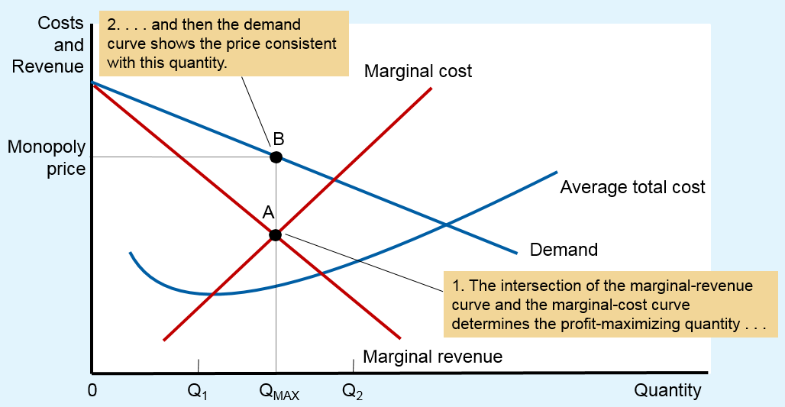
Figure 4 Profit Maximization for a Monopoly
A monopoly maximizes profit by choosing the quantity at which marginal revenue equals marginal cost (point A).
It then uses the demand curve to find the price that will induce consumers to buy that quantity (point B).

Slide 18
Production and Pricing Decisions Part 6
Profit maximization
Perfect competition: P=MR=MC
Price equals marginal cost
Monopoly: P>MR=MC
Price exceeds marginal cost
A monopoly’s profit
Profit = TR – TC = (P – ATC) ˣ Q

Slide 19
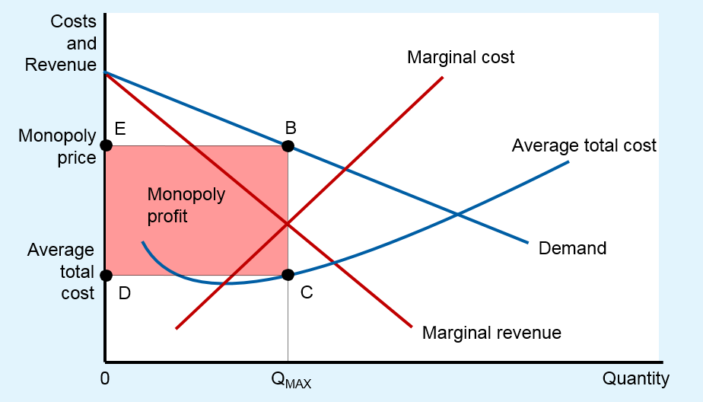
Figure 5 The Monopolist’s Profit
The area of the box BCDE equals the profit of the monopoly firm.
The height of the box (BC) is price minus average total cost, which equals profit per unit sold.
The width of the box (DC) is the number of units sold.

Slide 20
Monopoly Drugs versus Generic Drugs
Market for pharmaceutical drugs
New drug, patent laws, monopoly
Produce Q where MR=MC
P>MC
Generic drugs: competitive market
Produce Q where MR=MC
And P=MC
Price of the competitively produced generic drug
Below the monopolist’s price

Slide 21
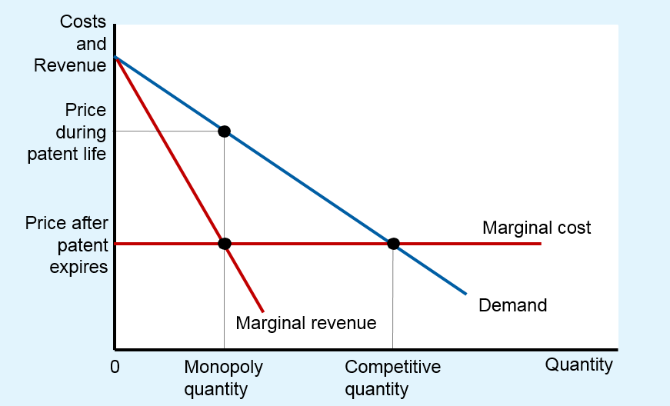
Figure 6 The Market for Drugs
When a patent gives a firm a monopoly over the sale of a drug, the firm charges the monopoly price, which is well above the marginal cost of making the drug. When the patent on a drug runs out, new firms enter the market, making it more competitive. As a result, the price falls from the monopoly price to marginal cost.

Slide 22
The Welfare Cost of Monopolies Part 1
Total surplus
Economic well-being of buyers and sellers in a market
Sum of consumer surplus and producer surplus
Consumer surplus
Consumers’ willingness to pay for a good
Minus the amount they actually pay for it

Slide 23
The Welfare Cost of Monopolies Part 2
Producer surplus
Amount producers receive for a good
Minus their costs of producing it
Benevolent planner: maximize total surplus
Socially efficient outcome
Produce quantity where
Marginal cost curve intersects demand curve
Charge P=MC

Slide 24
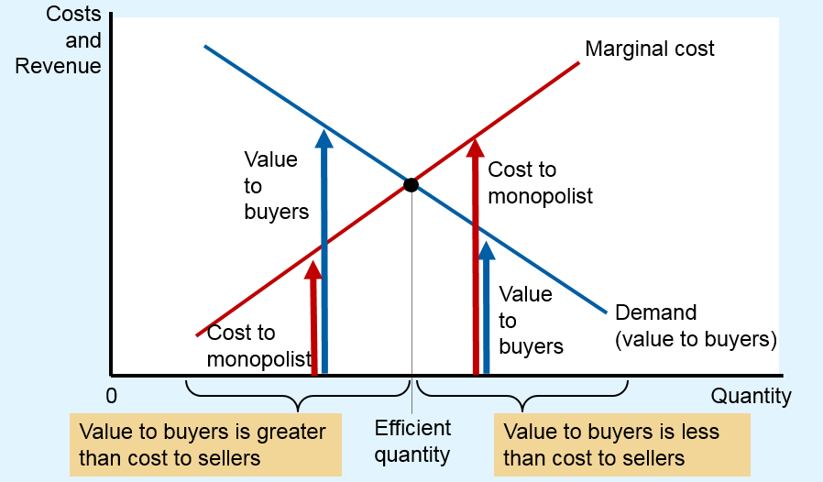
Figure 7 The Efficient Level of Output
A benevolent social planner maximizes total surplus in the market by choosing the level of output where the demand curve and marginal-cost curve intersect.
Below this level, the value of the good to the marginal buyer (as reflected in the demand curve) exceeds the marginal cost of making the good.
Above this level, the value to the marginal buyer is less than marginal cost.

Slide 25
The Welfare Cost of Monopolies Part 3
Monopoly
Produce quantity where MC = MR
Produces less than the socially efficient quantity of output
Charge P > MC
Deadweight loss
Triangle between the demand curve and MC curve

Slide 26
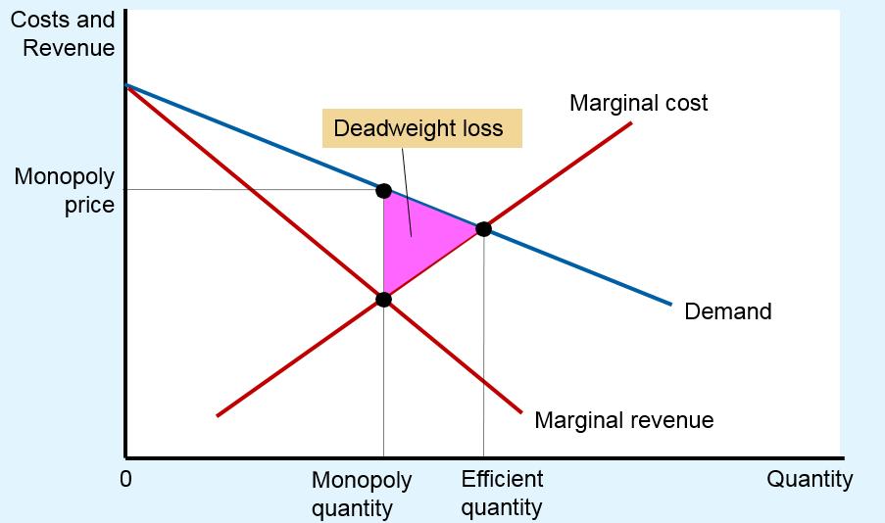
Figure 8 The Inefficiency of Monopoly
Because a monopoly charges a price above marginal cost, not all consumers who value the good at more than its cost buy it. Thus, the quantity produced and sold by a monopoly is below the socially efficient level. The deadweight loss is represented by the area of the triangle between the demand curve (which reflects the value of the good to consumers) and the marginal-cost curve (which reflects the costs of the monopoly producer).

Slide 27
The Welfare Cost of Monopolies Part 4
The monopoly’s profit: a social cost?
Monopoly - higher profit
Not a reduction of economic welfare
Bigger producer surplus
Smaller consumer surplus
Not a social problem
Social loss = Deadweight loss
From the inefficiently low quantity of output

Slide 28
Price Discrimination Part 1
Price discrimination
Business practice
Sell the same good at different prices to different customers
Rational strategy to increase profit
Requires the ability to separate customers according to their willingness to pay
Can raise economic welfare

Slide 29
Price Discrimination Part 2
Perfect price discrimination
Charge each customer a different price
Exactly his or her willingness to pay
Monopoly firm gets the entire surplus (Profit)
No deadweight loss

Slide 30
Price Discrimination Part 3
Without price discrimination
Single price > MC
Consumer surplus
Producer surplus (Profit)
Deadweight loss

Slide 31
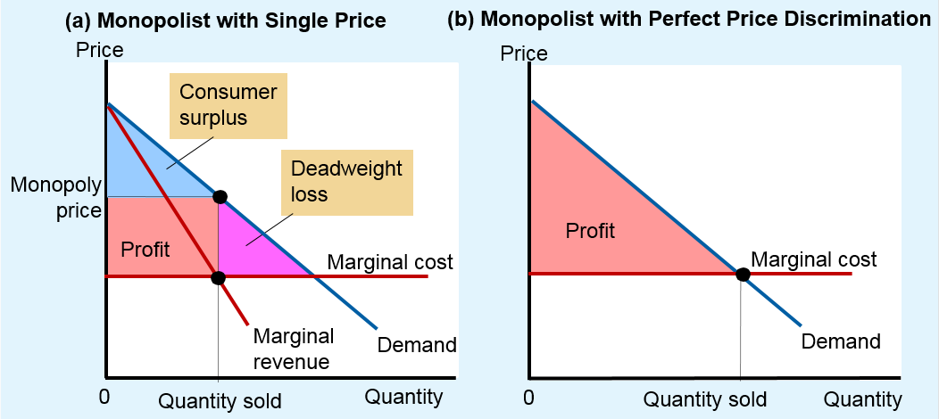
Figure 9 Welfare with and without Price Discrimination
Panel (a) shows a monopoly that charges the same price to all customers. Total surplus in this market equals the sum of profit (producer surplus) and consumer surplus.
Panel (b) shows a monopoly that can perfectly price discriminate. Because consumer surplus equals zero, total surplus now equals the firm’s profit.
Comparing these two panels, you can see that perfect price discrimination raises profit, raises total surplus, and lowers consumer surplus.

Slide 32

Price Discrimination Part 4
Examples of price discrimination
Movie tickets
Lower price for children and seniors
Airline prices
Lower price for round-trip with Saturday night stay
“Would it bother you to hear how little I paid for this flight?”

Slide 33
Price Discrimination Part 5
Examples of price discrimination
Discount coupons
Not all customers are willing to spend time to clip coupons
Financial aid
High tuition and need-based financial aid
Willingness to pay
Quantity discounts
Customer pays a higher price for the first unit bought than for the last unit bought

Slide 34
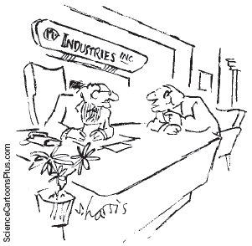
Public Policy Toward Monopolies Part 1
Increasing competition with antitrust laws
Sherman Antitrust Act, 1890
Clayton Antitrust Act, 1914
Prevent mergers
Break up companies
Prevent companies from
coordinating their activities
to make markets less competitive
“But if we do merge with Amalgamated, we’ll have enough resources to fight the anti-trust violation caused by the merger.”

Slide 35
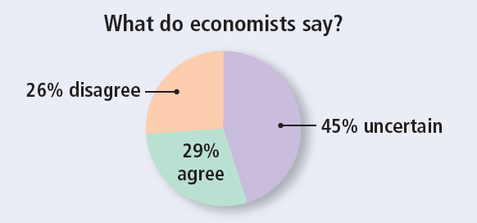
ASK THE EXPERTS
Airline Mergers
“If regulators had not approved mergers in the past decade between major networked airlines, travelers would be better off today.”

Slide 36
Public Policy Toward Monopolies Part 2
Regulation
Regulate the behavior of monopolists
Price
Common in case of natural monopolies
Marginal-cost pricing
May be less than ATC
No incentive to reduce costs

Slide 37
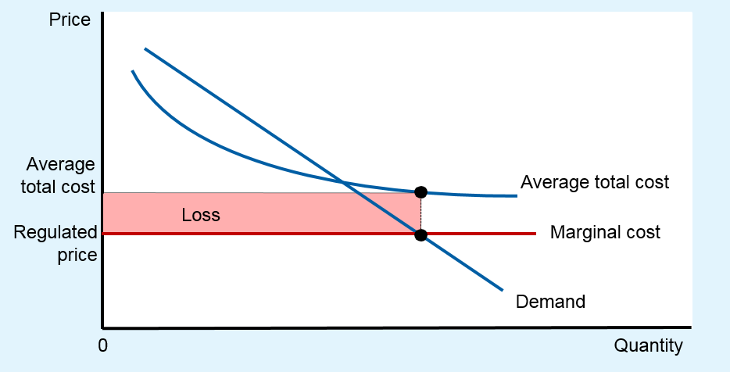
Figure 10 Marginal-Cost Pricing for a Natural Monopoly
Because a natural monopoly has declining average total cost, marginal cost is less than average total cost. Therefore, if regulators require a natural monopoly to charge a price equal to marginal cost, price will be below average total cost, and the monopoly will lose money.

Slide 38
Public Policy Toward Monopolies Part 3
Public ownership
How the ownership of the firm affects the costs of production
Private owners
Incentive to minimize costs
Public owners (government)
If it does a bad job, losers are the customers and taxpayers

Slide 39
Public Policy Toward Monopolies Part 4
Do nothing
Some economists argue that it is often best for the government not to try to remedy the inefficiencies of monopoly pricing
Determining the proper role of the government in the economy requires judgments about politics as well as economics

Slide 40
Table 2 Competition versus Monopoly: A Summary Comparison
Empty Cell | Competition | Monopoly
Similarities | Empty Cell | Empty Cell
Goal of firms | Maximize profits | Maximize profits
Rule for maximizing | MR= MC | MR= MC
Can earn economic profits in the short run? | Yes | Yes
Differences | Empty Cell | Empty Cell
Number of firms | Many | One
Marginal revenue | MR - P | MR < P
Price | P= MC | P> MC
Produces welfare-maximizing level of output? | Yes | No
Entry in the long run? | Yes | No
Can earn economic profits in the long run? | No | Yes
Price discrimination possible? | No | Yes

